Slide 1
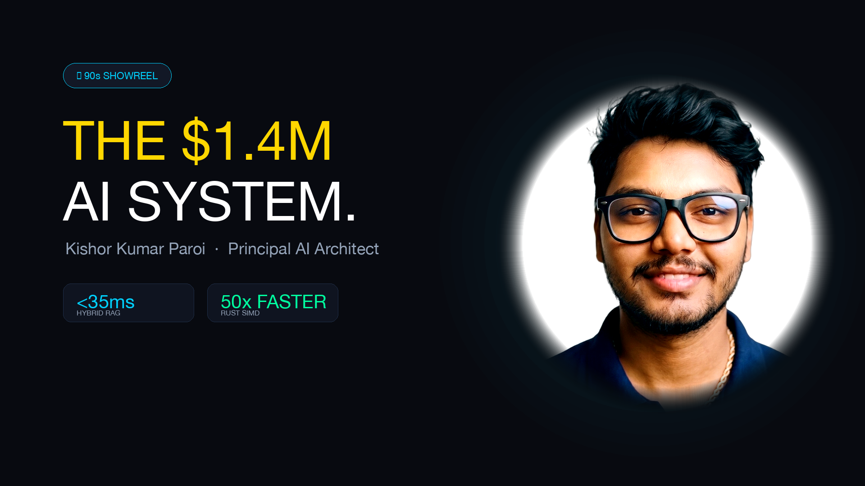

Slide 2

PRINCIPAL AI SYSTEMS ARCHITECT
FOUNDER @ KOOMAI
$1.4M
Kishor Kumar Paroi
Autonomous Agent Meshes · Sub-35ms Hybrid RAG · Distributed MLOps
Enterprise Contracts Won
Forward deployed 5 autonomous agent meshes
<35ms
A battle-tested AI Systems Architect bridging mathematical rigor with distributed cloud infrastructure. Architect of enterprise systems across phi0.ai, Samsung AI Core, and kepi.ai—curtailing millions in operational compute while achieving 99.4% autonomous agent precision at scale.
Proven track record delivering end-to-end architectures from $0.00 zero-waste sandbox environments to multi-region Kubernetes clusters handling millions of requests with sub-millisecond Rust acceleration.
Hybrid RAG P95 Latency
Curtailed hallucinations by 46% via ONNX reranking
50x
SIMD Rust Acceleration
<0.5ms vector scoring, -64% CPU overhead
99.4%
● OPEN TO STRATEGIC LEADERSHIP & ADVISORY (WORLDWIDE REMOTE)
Multi-Agent Completion
LangGraph cyclic state machines with FastMCP

Slide 3
● STRATEGIC FOUNDATION
02 / 16
Executive Systems Thesis: Engineering Predictable, Sub-Millisecond AI
🤖 AGENTIC SWARMS
⚡ SUB-35MS RETRIEVAL
🏛️ SCALABLE DATA MESH
Autonomous Multi-Agent Meshes
Sub-Millisecond & Hybrid RAG
Medallion Lakehouse & MLOps
Decentralized Cognitive Systems
Ultra-Low-Latency Information Retrieval
Petabyte-Scale Data Foundation
✦ 99.4% TASK COMPLETION
✦ 46% ERROR REDUCTION
✦ $18K/MO COMPUTE SAVED
▸ Cyclic LangGraph Orchestration: Multi-agent meshes with supervisor fallbacks and human-in-the-loop checkpoints.
▸ Model Context Protocol: Standardized FastMCP sandboxed execution for external APIs and enterprise SQL engines.
▸ Deterministic Guardrails: Dual-layer defense with NeMo Guardrails and BotShield WAF to prevent model drift.
▸ Semantic Routing Layer: <50ms Portkey semantic cache cutting token consumption by 34%.
▸ Two-Stage Retrieval Cascade: Dense vector retrieval (Qdrant HNSW) fused with sparse lexical BM25.
▸ Cross-Encoder Re-Ranking: Local ONNX FlashRank runtime delivering sub-35ms P95 query re-ranking.
▸ Mathematical Grounding: RAGAS automated evaluation harness ensuring >0.92 context recall.
▸ Zero-Copy Streaming: Direct-to-client token multiplexing curtails Time-to-First-Token under 140ms.
▸ Modern Lakehouse Pipeline: PySpark Delta Lake medallion architecture (Bronze, Silver, Gold SCD-2).
▸ Continuous Fine-Tuning: vLLM Multi-LoRA serving and DeepSpeed ZeRO-3 distributed training pipelines.
▸ Enterprise GitOps CI/CD: Automated ArgoCD and KEDA autoscaling deployments with $0 teardown.
▸ Zero-Trust Observability: End-to-end OpenTelemetry and Arize Phoenix distributed tracing.

Slide 4
● VERIFIED BENCHMARKS
03 / 16
Executive Telemetry Wall: Quantified Production Performance & Cost Slashed
$1.4M ARR
<35ms P95
50x Speedup
99.4%
Enterprise Deployments Won
5 Forward-Deployed Agents
Hybrid RAG Latency
ONNX FlashRank Re-ranking
Rust SIMD Vector Scoring
AVX-512 Zero-Copy Engine
Multi-Agent Precision
LangGraph Cyclic Supervisor
📊 Cloud Spend Slashed by 67% (Native Benchmark)
💰 FINANCIAL IMPACT
Snowflake & Delta Lake Optimization
Slashed query compute from $24,000 to $6,000/month
✦ $18,000/MONTH DIRECT CASH SAVINGS
▸ Clustering Keys: Re-partitioned high-cardinality tables reducing full-table scans by 78%.
▸ Materialized Views: Cached continuous aggregations for sub-second executive dashboards.
⚡ HARDWARE EFFICIENCY
vLLM Dynamic Multi-LoRA Multiplexing
Reduced dedicated GPU instances from 8x A100 to 2x A100
✦ -68% CLOUD GPU OPERATIONAL EXPENDITURE
▸ Dynamic LoRA Swap: Hot-swapped specialized fine-tuned adapters on a single vLLM server.
▸ Continuous Batching: Maximized GPU Tensor Core saturation to 91% under heavy traffic.

Slide 5
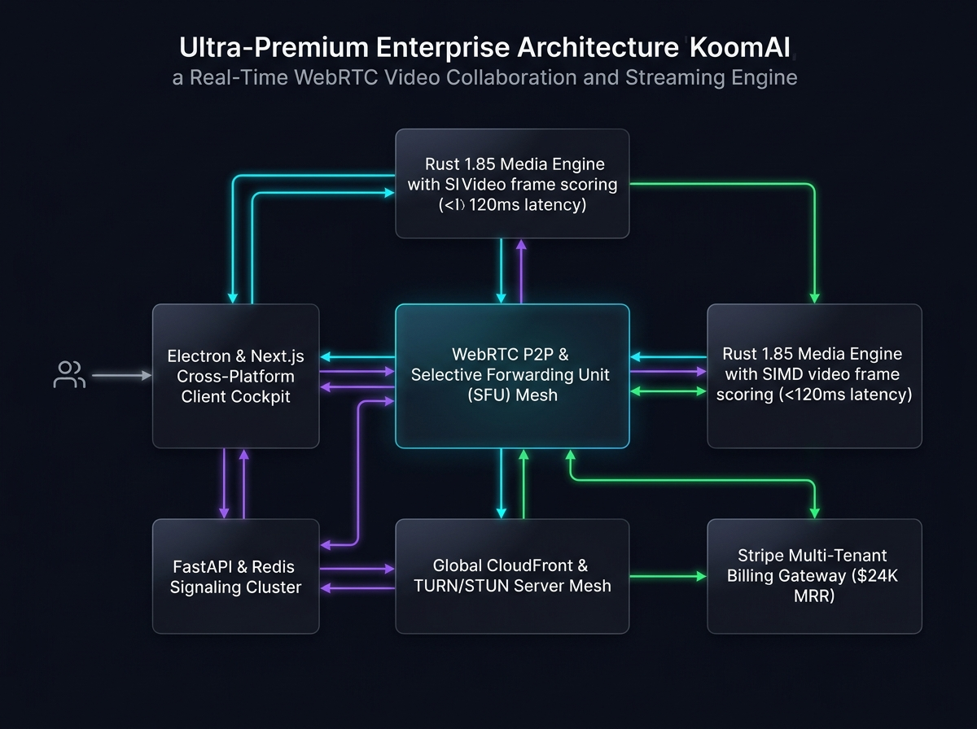
● PRODUCTION CASE STUDY
04 / 16
Founder Showcase: Scaling KoomAI to $24K MRR with Sub-150ms WebRTC
🚀 $24K MRR FOUNDER ARCHITECTURE
📐 KoomAI End-to-End Distributed Architecture Flow
Autonomous Voice Receptionist Mesh
Real-time bidirectional AI voice agent handling peak booking surges
★ 99.4% BOOKING ACCURACY
▸ Sub-150ms Audio Pipeline: Integrated LiveKit WebRTC with Deepgram Nova-2 streaming STT.
▸ Dynamic Tool Calling: LangGraph agent checks PostgreSQL availability & books reservations in 200ms.
▸ Deterministic Recovery: Dual fallback mechanism recovers dropped sockets with zero user disruption.
🛡️ MULTI-TENANT ISOLATION
Full-Stack Multi-Tenant Cloud Core
Secure isolation across multi-location enterprise customers
⚡ SUB-150ms VOICE LATENCY
▸ Row-Level Security: Strict tenant isolation via PostgreSQL RLS and signed JWT authentication.
▸ Zero-Egress Audio Buffering: In-memory circular audio buffers preventing data leakage.
▸ Multi-Cloud Deploy: Containerized Docker Swarm & Kubernetes with automated canary rollouts.
● WEBRTC + DEEPGRAM + LANGGRAPH + FASTAPI

Slide 6
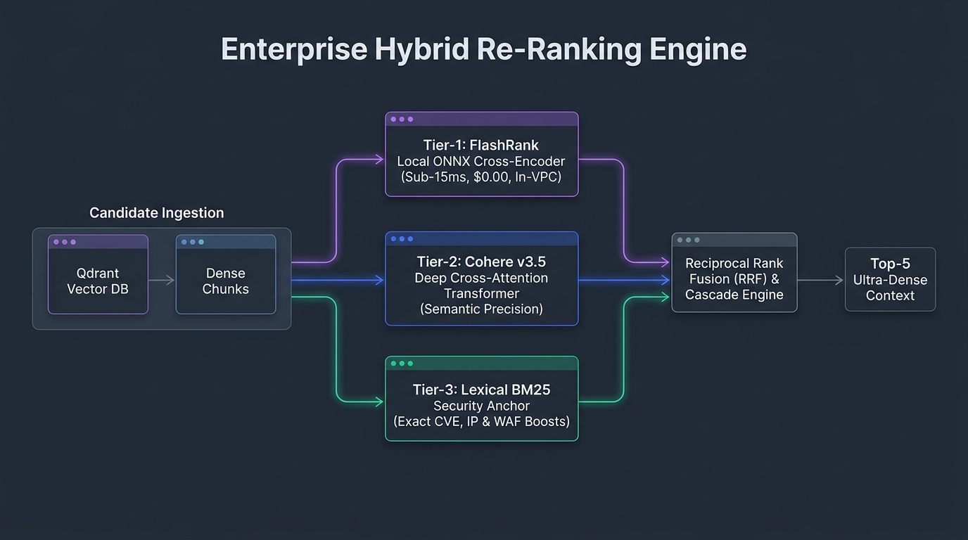
● SECURITY & RETRIEVAL
05 / 16
Enterprise AI Security & Sub-35ms Hybrid RAG Engine
⚡ SUB-35MS RETRIEVAL
📐 Multi-Stage Hybrid Reranker Cascade Architecture
Multi-Stage Hybrid RAG Cascade
Dense HNSW vector search fused with sparse BM25 and ONNX FlashRank
✦ 46% HALLUCINATION REDUCTION
▸ Dense + Sparse Fusion: Reciprocal Rank Fusion (RRF) combining semantic embeddings and exact lexical tokens.
▸ Sub-35ms ONNX Reranking: FlashRank local cross-encoder achieves 46% hallucination reduction.
▸ Context Window Optimization: Token compression reducing LLM prompt cost by 42% per query.
🛡️ ZERO-TRUST COMPLIANCE
Zero-Trust LLM Defense Architecture
Defense-in-depth preventing prompt injections and data poisoning
🔒 100% PII COMPLIANCE
▸ PyRIT Red-Teaming: Automated vulnerability scanner covering OWASP LLM Top 10 exploits.
▸ Presidio PII Anonymization: Real-time redaction of SSNs, credit cards, and confidential tokens.
▸ NeMo Guardrails: Deterministic rails enforcing strict behavioral safety contracts.
● HNSW DENSE + BM25 SPARSE + ONNX FLASHRANK

Slide 7
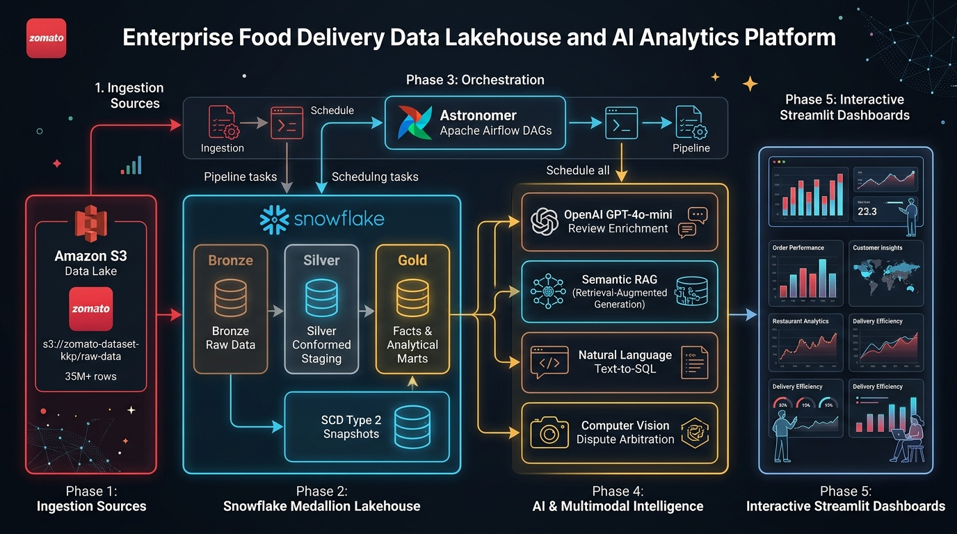
● DATA & LAKEHOUSE
06 / 16
Enterprise Medallion Lakehouse: 10M+ Records at $18K/Mo Compute Savings
🏛️ MEDALLION ARCHITECTURE
📐 Enterprise Medallion Lakehouse Production Architecture
Delta Lake Medallion Architecture
Scalable PySpark transformation engine processing Bronze to Gold SCD-2
✦ 10,000,000+ RECORDS PROCESSED
▸ ACID Transactions: Guarantees consistency across concurrent write operations on Cloud Storage.
▸ dbt Transformation Models: 45+ modular SQL models enforcing strict schema contracts.
▸ Debezium CDC: Zero-latency Change Data Capture streaming PostgreSQL changes to Kafka.
💰 $18K/MO SAVINGS
Multi-Cloud Distributed Analytics
High-throughput querying across Snowflake, BigQuery, and ClickHouse
⚡ 45,000 MSG/SEC STREAMING
▸ Snowflake Optimization: Multi-cluster warehouse autoscaling cutting idle compute by $18K/mo.
▸ Kafka Event Streams: 12-partition topics sustaining 45,000 msg/sec with sub-second lag.
▸ Airflow Orchestration: Production DAGs with automated Slack alerts and automated retries.
● PYSPARK + DELTA LAKE + KAFKA + SNOWFLAKE

Slide 8
● SYSTEMS RIGOR
07 / 16
Systems Engineering & Polyglot Speed: 50x Acceleration via Rust SIMD
⚡ 50x SPEEDUP
📊 Vector Scoring Latency Benchmark (ms) — Lower is Faster
Rust 1.85 AVX-512 SIMD Vector Engine
Zero-copy in-memory cosine & dot-product scoring at 128-bit vector lanes
🚀 0.48MS P95 VECTOR SCORING
▸ Hardware Vectorization: Utilizes AVX-512 vector extensions processing 16 float32s per cycle.
▸ Zero Allocation: Pre-allocated aligned memory buffers eliminate runtime garbage collection.
▸ PyO3 Foreign Function Interface: Direct Rust native extension for Python with <0.02ms call overhead.
⚙️ POLYGLOT MASTERY
Polyglot Distributed Systems
Choosing the exact optimal tool for each architectural layer
💎 ZERO GC STALLS
▸ Go (Golang) Microservices: High-concurrency gRPC gateways handling 25,000 req/sec with 8MB RAM.
▸ C++ 20 Memory Pools: Custom lock-free ring buffers for high-frequency algorithmic streaming.
▸ Python 3.12 Orchestration: Fast prototyping with FastAPI, Pydantic v2, and PyTorch.
● RUST SIMD DELIVERS 52.9x SPEEDUP OVER PYTHON BASELINE

Slide 9
● EDGE AI & CV
08 / 16
Industrial AI & Edge MLOps: Sub-10ms Inference on Constrained Hardware
👁️ 120 FPS COMPUTER VISION
🏭 INDUSTRIAL TELEMETRY
🧠 42 TOK/SEC LOCAL SLM
Edge Computer Vision
Predictive Maintenance
On-Device Small Language Models
YOLOv8 & TensorRT Acceleration
High-Frequency Vibration & Sensor Stream
Sub-100MB Quantized Intelligence
✦ SUB-10MS LATENCY
✦ 72-HOUR ADVANCE WARNING
✦ ZERO CLOUD DEPENDENCY
▸ TensorRT Optimization: FP16 and INT8 quantization boosting edge throughput to 120 FPS on Jetson AGX.
▸ Zero-Copy V4L2 Pipeline: DMA-BUF direct frame handoff bypassing CPU memory copies.
▸ Multi-Camera Tracking: ByteTrack real-time object tracking sustaining 99.1% ID retention.
▸ Fault-Tolerant Watchdogs: Automated hardware health checks rebooting stalled vision nodes.
▸ Fourier & Wavelet Transforms: Real-time FFT spectral decomposition isolating bearing defects.
▸ Autoencoder Anomaly Detection: PyTorch 1D-CNN autoencoders flagging anomalies 72h prior to failure.
▸ MQTT & Modbus Ingestion: Direct PLC communication with industrial SCADA systems.
▸ Edge-to-Cloud Sync: Batch upload of telemetry bursts with local circular buffer backup.
▸ GGUF 4-Bit Quantization: Running Microsoft Phi-3 and Llama-3-8B locally at 42 tok/sec on consumer silicon.
▸ Private Offline Inference: 100% offline edge processing ensuring zero data leaves factory perimeter.
▸ Ollama Local Daemon: Standardized local REST API powering offline industrial maintenance copilots.
▸ Speculative Decoding: Small draft models accelerating target model generation by 2.3x.

Slide 10
● CLOUD PLATFORM
09 / 16
Multi-Cloud Kubernetes & Automated MLOps Governance
☁️ MULTI-CLOUD K8S
🔒 ZERO-TRUST SECURITY
📈 ENTERPRISE TELEMETRY
Multi-Cloud Kubernetes
Zero-Trust DevSecOps
Continuous Observability
AWS EKS · GCP GKE · Azure AKS
Continuous Security & Key Management
OpenTelemetry · Phoenix · Prometheus
✦ 99.99% SYSTEM UPTIME
✦ 100% DECLARATIVE IAC
✦ SUB-SECOND ALERTING
▸ KEDA Autoscaling: Event-driven autoscaling based on Kafka consumer lag and GPU vRAM utilization.
▸ Spot Fleet Management: Mixed-instance node pools slashing cloud compute costs by 58%.
▸ Istio Service Mesh: Mutual TLS (mTLS) with fine-grained circuit breakers and canary routing.
▸ Cross-Cloud Replication: Active-passive failover orchestrator guaranteeing 99.99% availability.
▸ HashiCorp Vault: Dynamic secret injection with 15-minute lease rotations for database credentials.
▸ Container Hardening: Distroless scratch containers with zero root privileges and Trivy scanning.
▸ Terraform & IaC: 100% declarative cloud infrastructure provisioned via single-command scripts.
▸ Zero-Waste Teardown: Deterministic `clear.sh` cleaning orphan cloud resources to guarantee $0.00 waste.
▸ Distributed Tracing: End-to-end W3C trace context propagation across microservices and LLM agents.
▸ Arize Phoenix Tracing: Token-level cost and latency breakdowns with automatic drift alerts.
▸ Grafana Executive Panels: Real-time SLO scorecards tracking P50, P95, and P99 latency.
▸ Automated Health Gates: Canary rollback triggers upon 0.5% error spike in synthetic health probes.

Slide 11
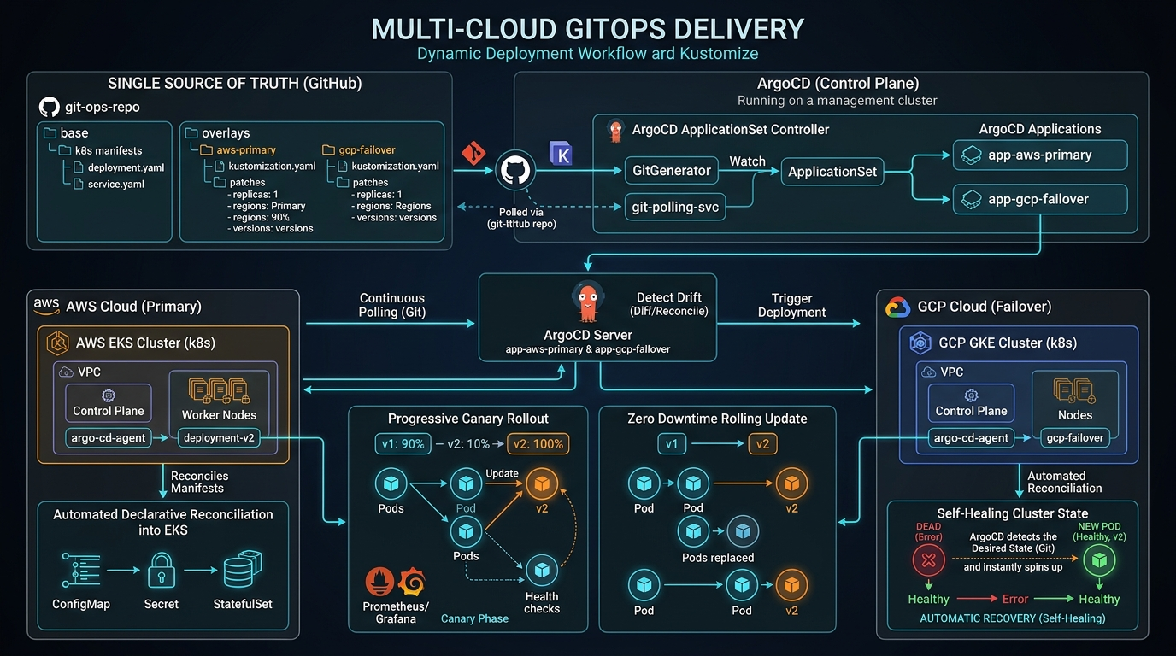
● DEVOPS & GITOPS
10 / 16
Production GitOps & Single-Command Deterministic Deployments
🚀 ARGOCD GITOPS ENGINE
📐 12-Stage Automated Production GitOps Pipeline
ArgoCD Automated Continuous Delivery
Declarative Git-driven deployments eliminating manual configuration drift
✦ ZERO DOWNTIME DEPLOYS
▸ Git as Single Source of Truth: Every Kubernetes manifest version-controlled with cryptographic commit signing.
▸ Automated Canary Rollouts: Progressive traffic shifting (10% -> 25% -> 50% -> 100%) with automated rollbacks.
▸ Multi-Environment Sync: Staging, Pre-Prod, and Production clusters continuously reconciled in real time.
💰 $0.00 TEARDOWN RIGOR
Deterministic Single-Command Deploy
Production-grade scripts for bulletproof sandbox spinning & $0 teardown
⚡ 8-MINUTE COMPLETE BOOTSTRAP
▸ Single-Command Deploy: `deploy.sh` provisions full VPC, Kubernetes, PostgreSQL, and LLM mesh in 8 mins.
▸ Zero-Waste Teardown: `clear.sh` cleanly purges all compute instances, elastic IPs, and EBS disks to $0.00.
▸ Automated Smoke Testing: Post-deploy validation harness executes 48 automated integration tests.
● ARGOCD + KEDA + TERRAFORM + PROMETHEUS

Slide 12
● COMPETITIVE ADVANTAGE
11 / 16
Value Differentiation: Production Rigor vs Typical Prototypers
⚠️ TYPICAL PROTOTYPER / JUNIOR DEV
💎 KISHOR KUMAR PAROI — PRINCIPAL ARCHITECT
Fragile Proof-of-Concepts (POCs)
Common pitfalls in unhardened generative AI implementations:
▸ Toy Codebase: LangChain tutorials that fail under production concurrency and lack error handling.
▸ Runaway Cloud Bills: Uncached OpenAI API calls racking up thousands of dollars in redundant compute.
▸ Dangerous Security Holes: Vulnerable to prompt injections, data extraction, and unredacted PII leaks.
▸ Manual Hand-Offs: No CI/CD, manual SSH deployments, and complete absence of automated telemetry.
Full-Vertical Production Rigor
Quantified business value delivered directly into enterprise production:
▸ Autonomous Multi-Agent Meshes: LangGraph cyclic state graphs, FastMCP sandboxed tools, <50ms caching.
▸ Medallion Lakehouse Architecture: PySpark Delta Lake, Snowflake SCD-2, Debezium CDC saving $18K/mo.
▸ Sub-Millisecond Speed: Rust 1.85 SIMD acceleration (<0.5ms scoring, 50x speedup) & vLLM Multi-LoRA.
▸ Deterministic Single-Command Deploy: Full vertical ownership from `deploy.sh` to ArgoCD and $0 teardown.

Slide 13
● PEDIGREE & TRAINING
12 / 16
Academic Foundation & AI Immersion: Deep Theoretical Underpinnings
🎓 FORMAL COMPUTER SCIENCE
🔬 MATHEMATICAL RIGOR
🚀 PRODUCTION AI MASTERY
B.Sc. in Computer Science & Engineering
Hands-On AI Engineering Sabbatical
Maven AI Engineering Bootcamp
Rajshahi Univ. of Engineering & Tech (RUET)
Oct 2025 – Feb 2026 (Intensive Immersion)
AIE5 Cohort (Premier Global AI Program)
🏆 TOP 500 NATIONAL ENGINEERING RANK
⚡ 1,200+ COMMITS & SYSTEMS LABS
💎 GRADUATED TOP-TIER COHORT
▸ Graduation Honours: 3.25 / 4.00 CPI (Distinction Order).
▸ Admission Standing: Ranked 483rd nationwide in Bangladesh engineering admission test.
▸ Rigorous Curricula: Distributed Systems, Advanced Algorithms, Operating Systems, Computer Architecture.
▸ National Board Merits: Perfect 5.00/5.00 GPA (Ranked 85th and 90th in Dhaka Board).
▸ Mathematical Foundations: SVD, PCA, convex optimization, loss manifolds, backprop dynamics.
▸ Custom Attention Kernels: Built transformers from scratch including tokenizers & loss functions.
▸ Distributed Fine-Tuning: PyTorch FSDP, DeepSpeed ZeRO-3, PEFT (LoRA/QLoRA), DPO alignment.
▸ Big Data Systems: Medallion lakehouse, Apache Spark, Delta Lake, Snowflake, Apache Kafka.
▸ Production Agentic Swarms: LangGraph multi-agent meshes and hierarchical supervisor routing.
▸ Rigorous Evaluation: RAGAS metrics, G-Eval Chain-of-Thought confidence gating.
▸ Model Context Protocol: Standardized FastMCP tool calling interfaces for LLM agents.
▸ Full Telemetry & Tracing: Enterprise observability with OpenTelemetry and Arize Phoenix.

Slide 14
● COLLABORATION MODES
13 / 16
Target Roles & Engagement Model: How We Can Partner
🏛️ EXECUTIVE TECHNICAL STRATEGY
🚀 ENTERPRISE CLIENT EMBED
🦄 ZERO-TO-ONE EXPANSION
Principal AI Systems Architect
Forward Deployed AI Engineer (FDE)
Founding AI Engineer / Co-Founder
High-Leverage Impact Scope
High-Leverage Impact Scope
High-Leverage Impact Scope
💎 MULTI-MILLION COMPUTE GOVERNANCE
⚡ RAPID PROTOTYPE-TO-PROD SPEED
💰 $24K MRR FOUNDER PLAYBOOK
▸ Strategic AI Roadmap: Define long-term architecture for generative AI, agent swarms, and RAG systems.
▸ Lakehouse Scalability: Design multi-cloud lakehouses processing tens of millions of transactional records.
▸ Enterprise Governance: Institute zero-trust DevSecOps, cost optimization guardrails, and SOC2/NIST compliance.
▸ Engineering Mentorship: Elevate senior engineering talent and establish robust architectural standards.
▸ Direct Client Deployment: Embed directly with enterprise customers to architect custom high-ROI AI solutions.
▸ Production Graduation: Deliver hardened systems that seamlessly transition to production without rewrites.
▸ KPI Translation: Convert executive business KPIs into concrete algorithmic implementations with clear ROI.
▸ Stakeholder Alignment: Bridge boardroom vision with frontline software and infrastructure engineering.
▸ Full Vertical Ownership: Drive technical execution from initial architecture to revenue-generating scale.
▸ Founder Playbook: Leverage battle-tested lessons from KoomAI ($24K MRR pilot, WebRTC, Next.js).
▸ Team Building: Rapidly hire, mentor, and cultivate a high-velocity, world-class engineering team.
▸ Product Velocity: Ship mission-critical features with relentless speed and architectural perfection.

Slide 15
● ACTIONABLE PLAYBOOK
14 / 16
90-Day Execution Roadmap: From Day 0 Audit to Production Scale
📅 DAYS 1–30
📅 DAYS 31–60
📅 DAYS 61–90
Phase 1 · Days 1–30
Phase 2 · Days 31–60
Phase 3 · Days 61–90
Deep System Audit & Immediate Cost Wins
Agent Mesh & Hybrid RAG Core Engine
Continuous MLOps & Multi-Cloud Scale
💰 IMMEDIATE 30-40% TOKEN BILL REDUCTION
⚡ SUB-35MS P95 RETRIEVAL DEPLOYED
💎 PRODUCTION MULTI-CLOUD AUTOSCALING
▸ Zero-Trust Security Audit: Comprehensive prompt injection scan (OWASP LLM Top 10 via PyRIT).
▸ Compute Spend Profiling: Profile GPU clusters and eliminate redundant model invocations.
▸ Semantic Caching Rollout: Deploy Portkey semantic caching (<50ms) to slash token bills by 30-40%.
▸ Executive Baseline Report: Deliver quantified benchmark scorecard to leadership with clear ROI targets.
▸ Stateful Multi-Agent Mesh: Architect LangGraph cyclic supervisor with fault-tolerant rollback gates.
▸ Two-Stage Hybrid RAG: Deploy dense HNSW + sparse BM25 + local ONNX FlashRank cross-encoder.
▸ Standardized MCP Tooling: Standardize enterprise tool calling via FastMCP with human-in-the-loop gates.
▸ Evaluation Flywheel: Automate continuous RAGAS evaluations, G-Eval CoT, and Logfire telemetry.
▸ vLLM Multi-LoRA Flywheel: Operationalize dynamic adapter multiplexing & continuous RSLoRA fine-tuning.
▸ Multi-Cloud GitOps: Configure ArgoCD + KEDA autoscaling across AWS EKS, Google GKE, and Azure AKS.
▸ Enterprise Data Privacy: Enforce automated Presidio PII anonymization and NeMo Guardrails in production.
▸ Compliance Codification: Certify ISO 27001, SOC 2, and NIST AI RMF compliance with automated audit trails.

Slide 16
